Slide 1
2024 S&C Preseason Update

Slide 2
Power Complex
Strength Block
Hypertrophy Block
Primers (Jumps, Decels, etc.)
Warm – Up

Slide 3
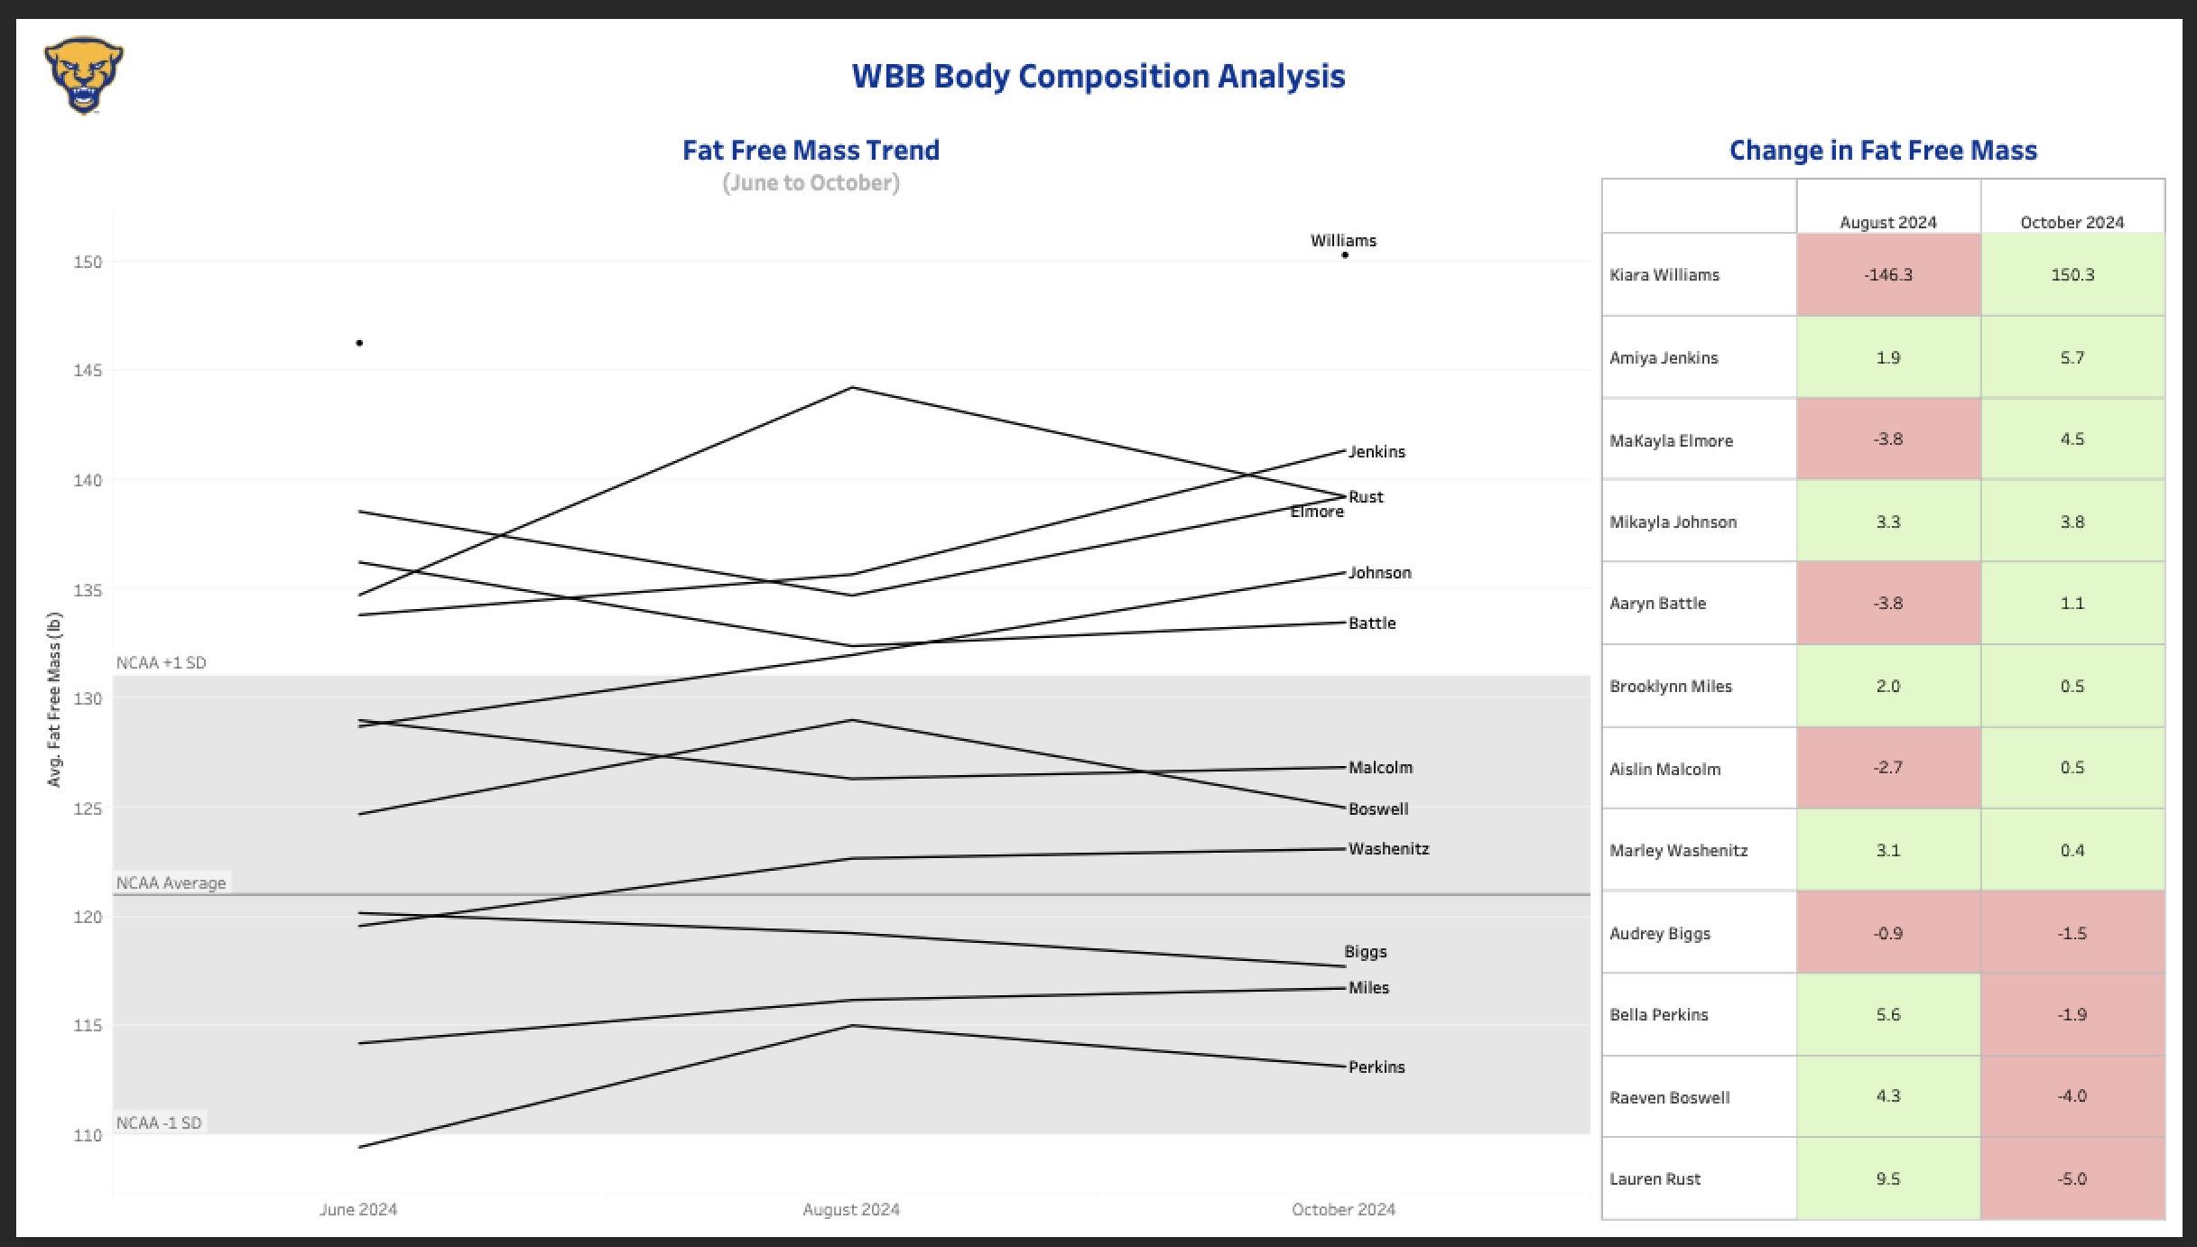

Slide 4
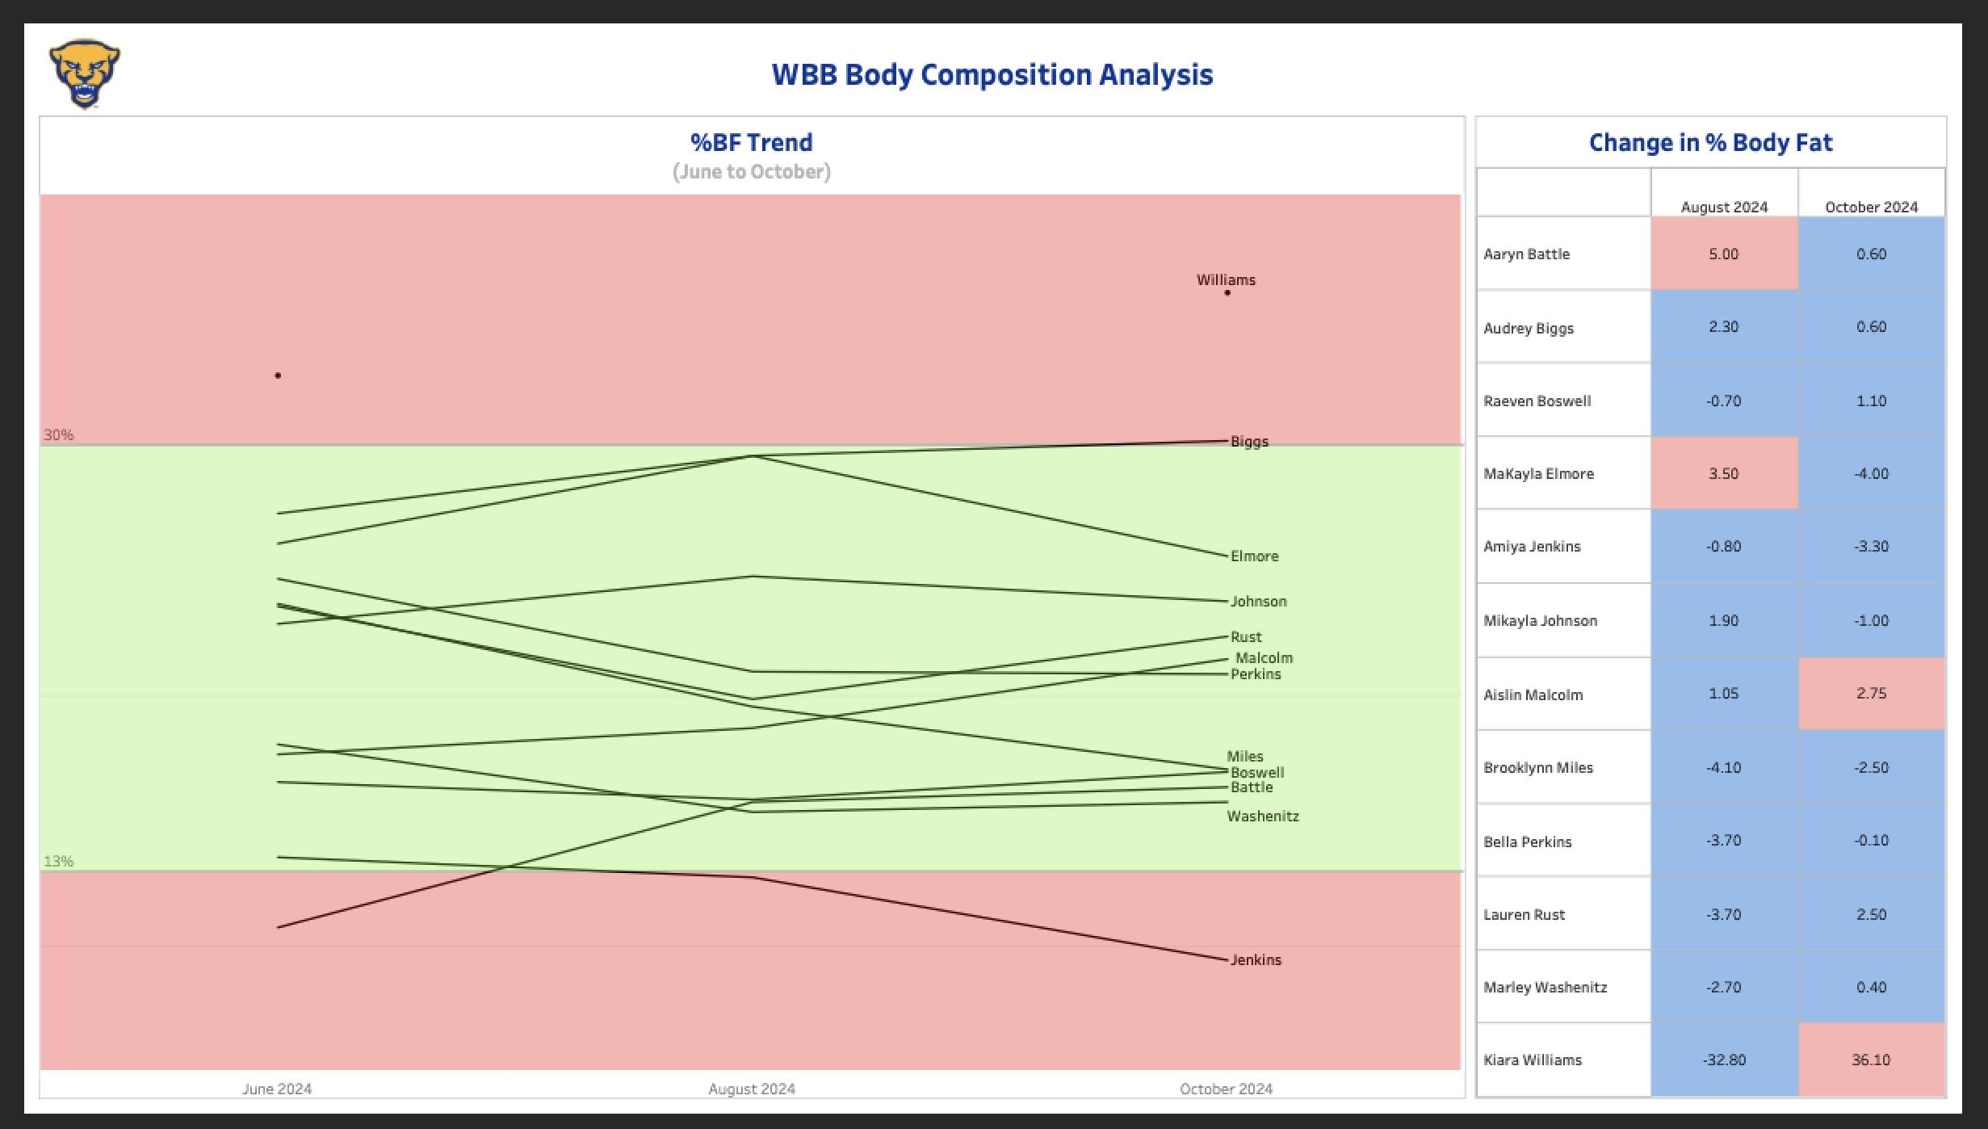

Slide 5
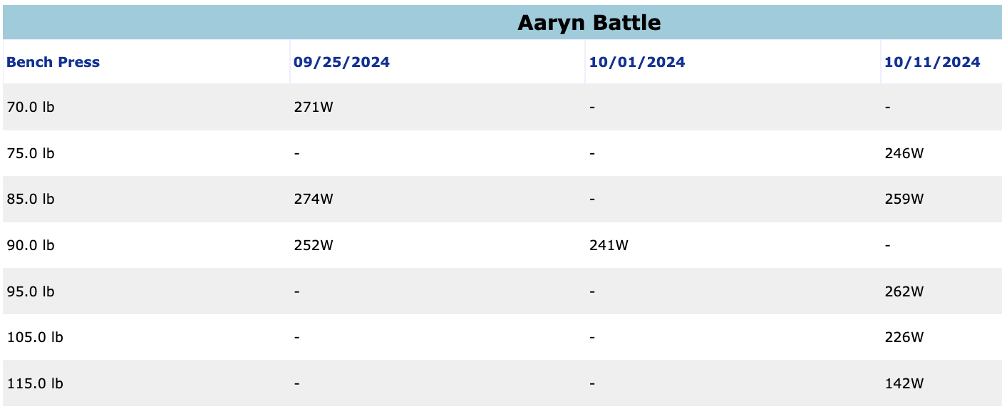
Battle – Bench Press

Slide 6
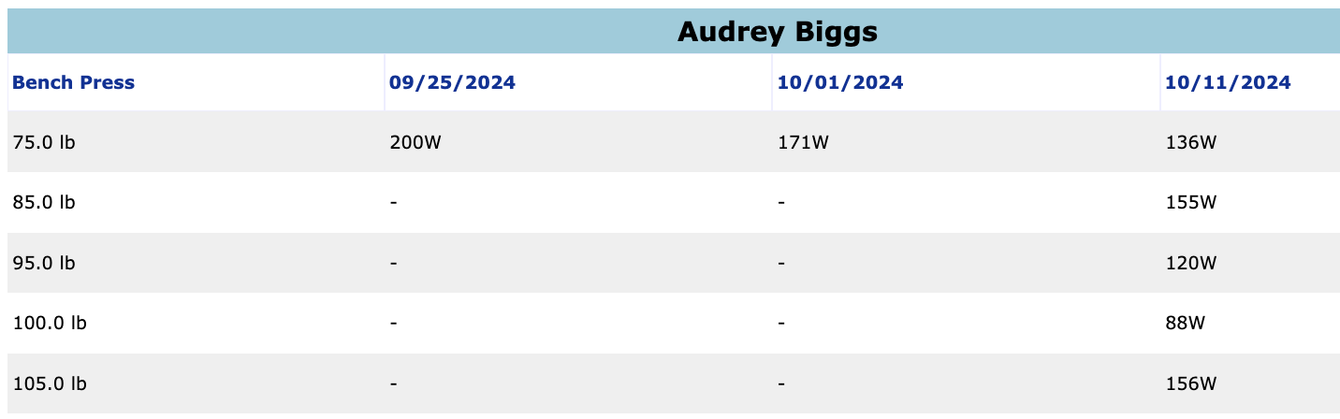
Biggs – Bench Press

Slide 7
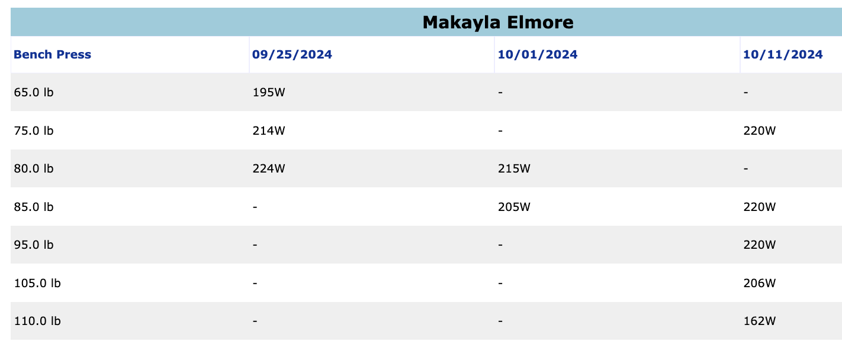
Elmore – Bench Press

Slide 8
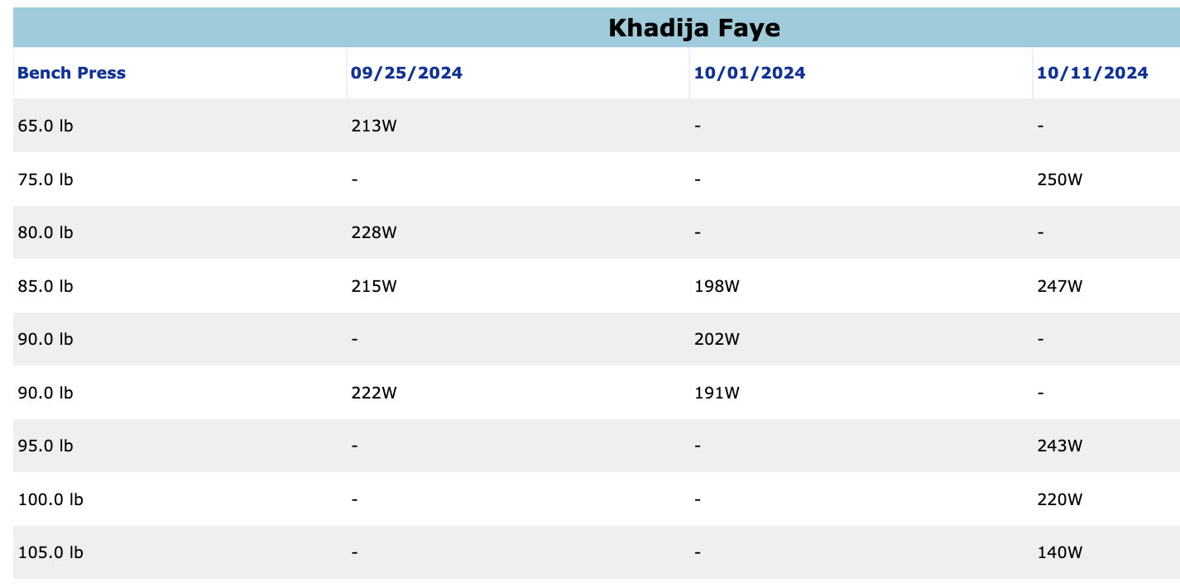
Faye – Bench Press

Slide 9
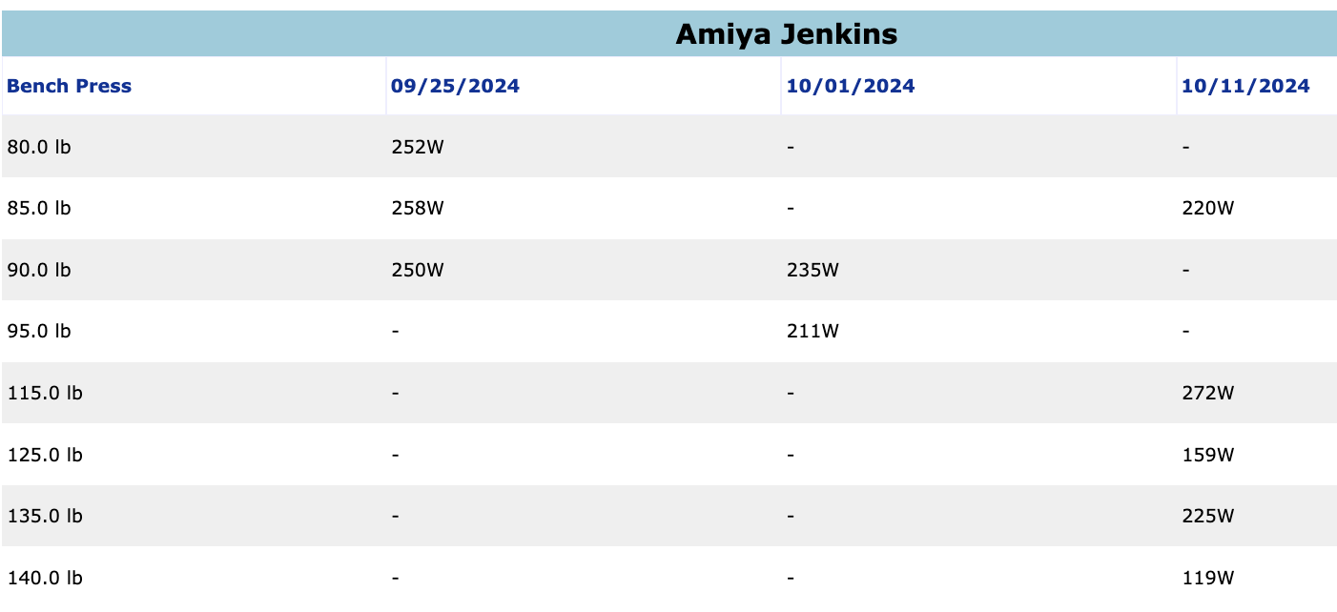
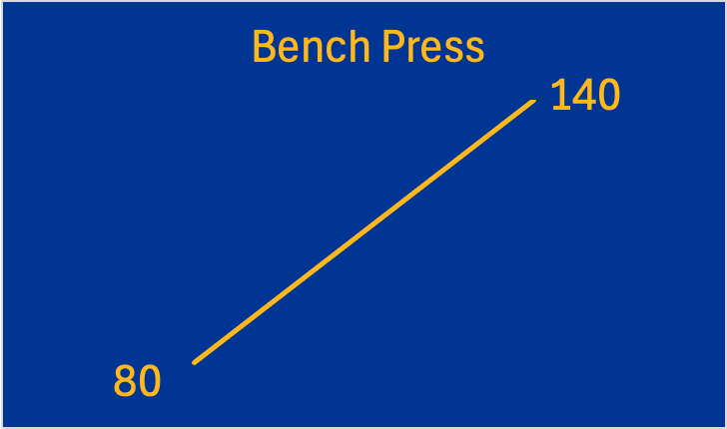
Jenkins – Bench Press

Slide 10
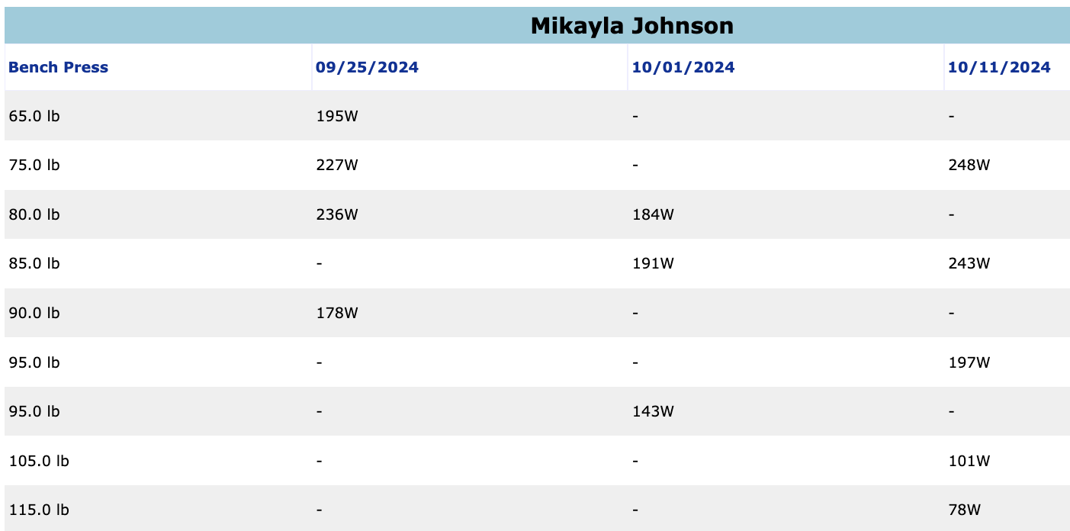
Johnson – Bench Press

Slide 11
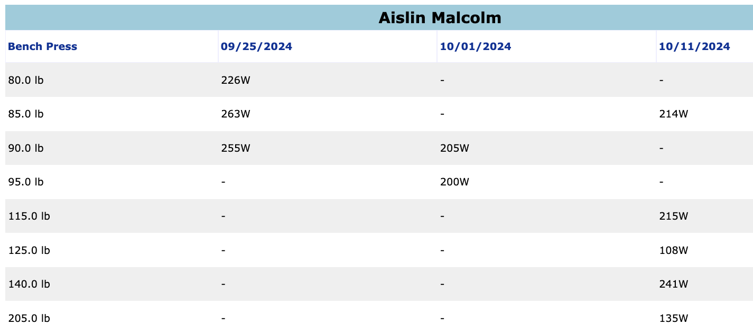
Malcolm – Bench Press

Slide 12
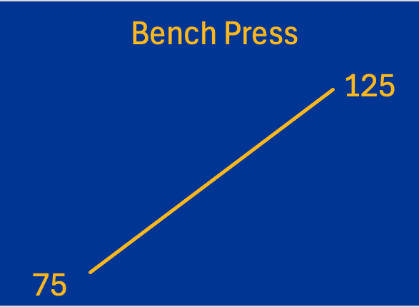
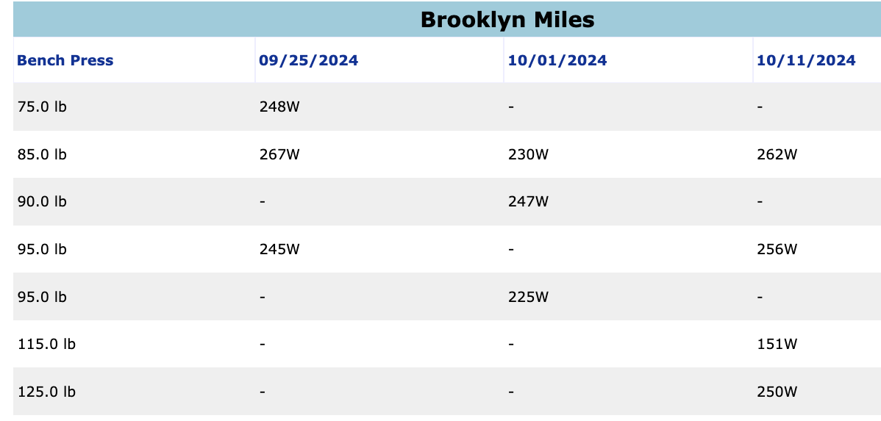
Miles – Bench Press

Slide 13
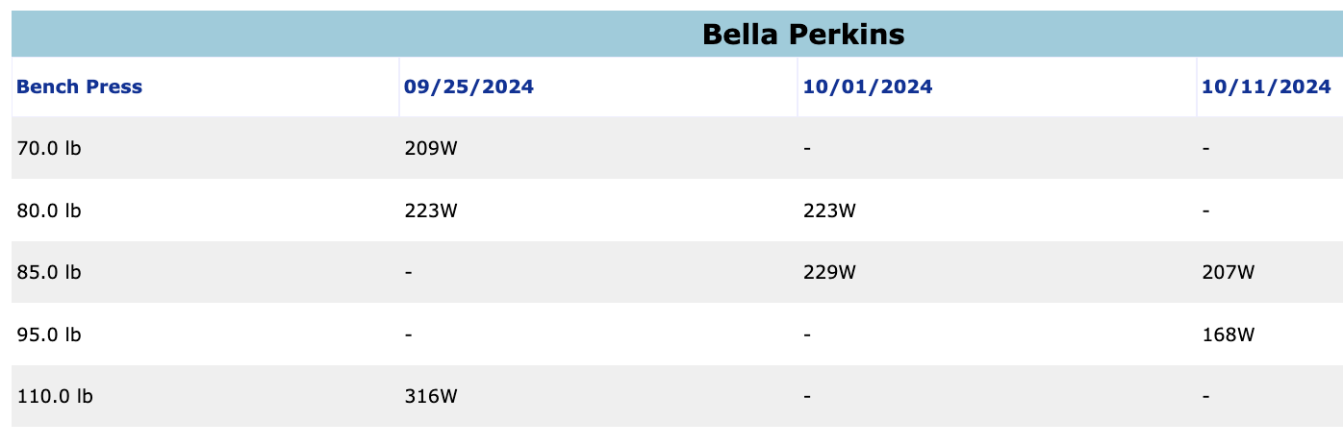
Perkins – Bench Press

Slide 14
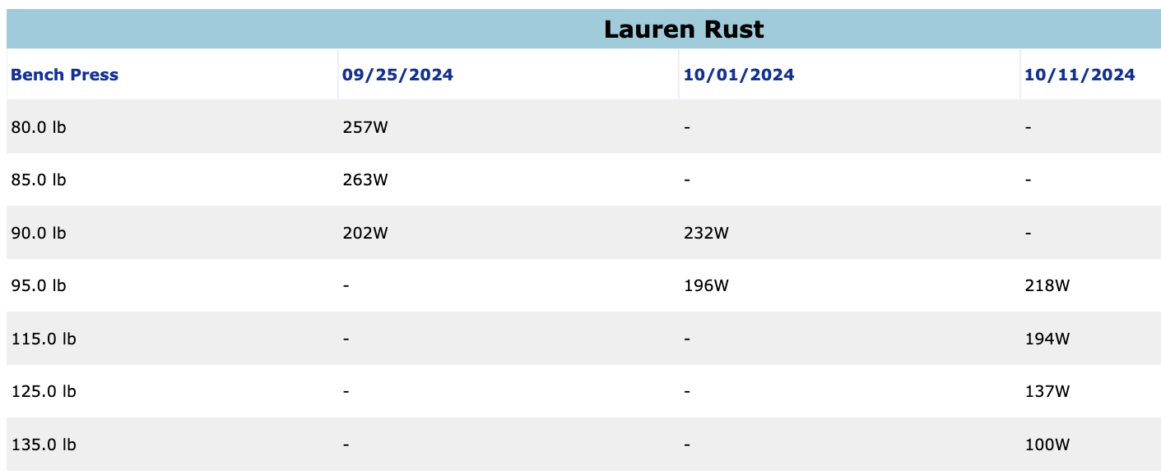
Rust – Bench Press

Slide 15
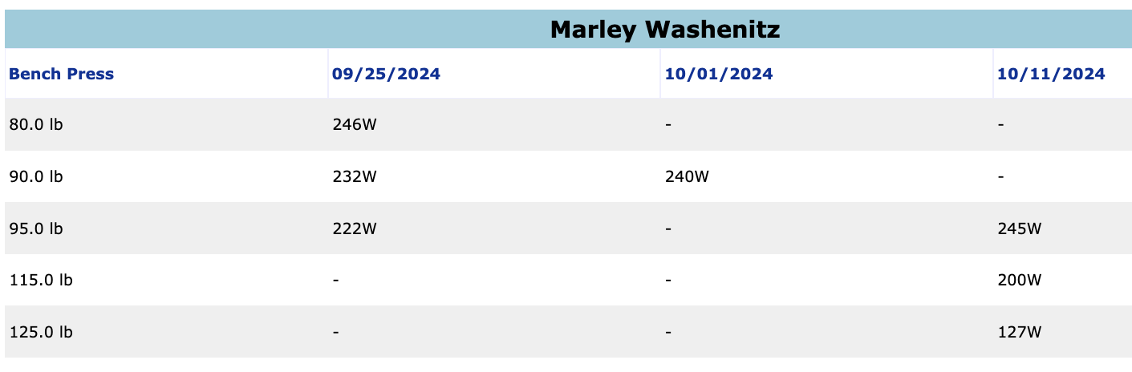
Washenitz – Bench Press

Slide 16
Incline Bench Press MAXES
Battle
Week 1 | 65
Week 2 | 100
Biggs
Week 1 | 65
Week 2 | 95
Elmore
Week 1 | 65
Week 2 | 95
Faye
Week 1 | 65
Week 2 | 100
Johnson
Week 1 | 65
Week 2 | 100
Malcolm
Week 1 | 65
Week 2 | 100
Miles
Week 1 | 75
Week 2 | 110
Perkins
Week 1 | 70
Week 2 | 100
Rust
Week 1 | 75
Week 2 | 95
Washenitz
Week 1 | 75
Week 2 | 110

Slide 17
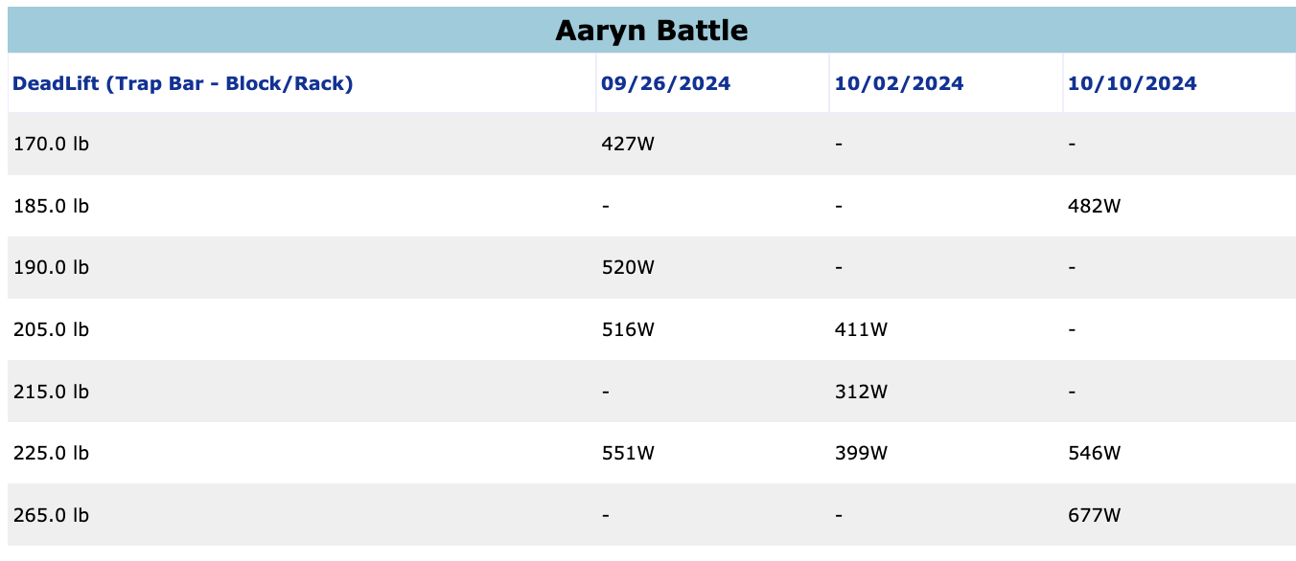
Battle – Deadlift

Slide 18
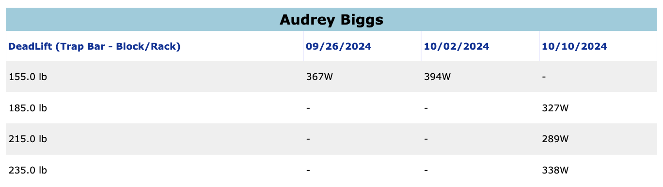
Biggs – Deadlift

Slide 19
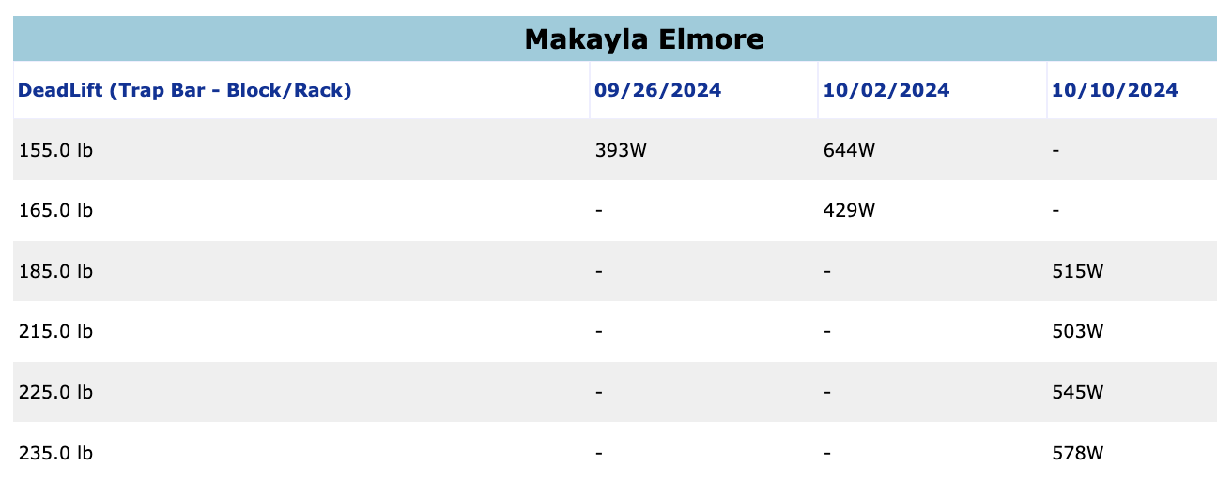
Elmore – Deadlift

Slide 20
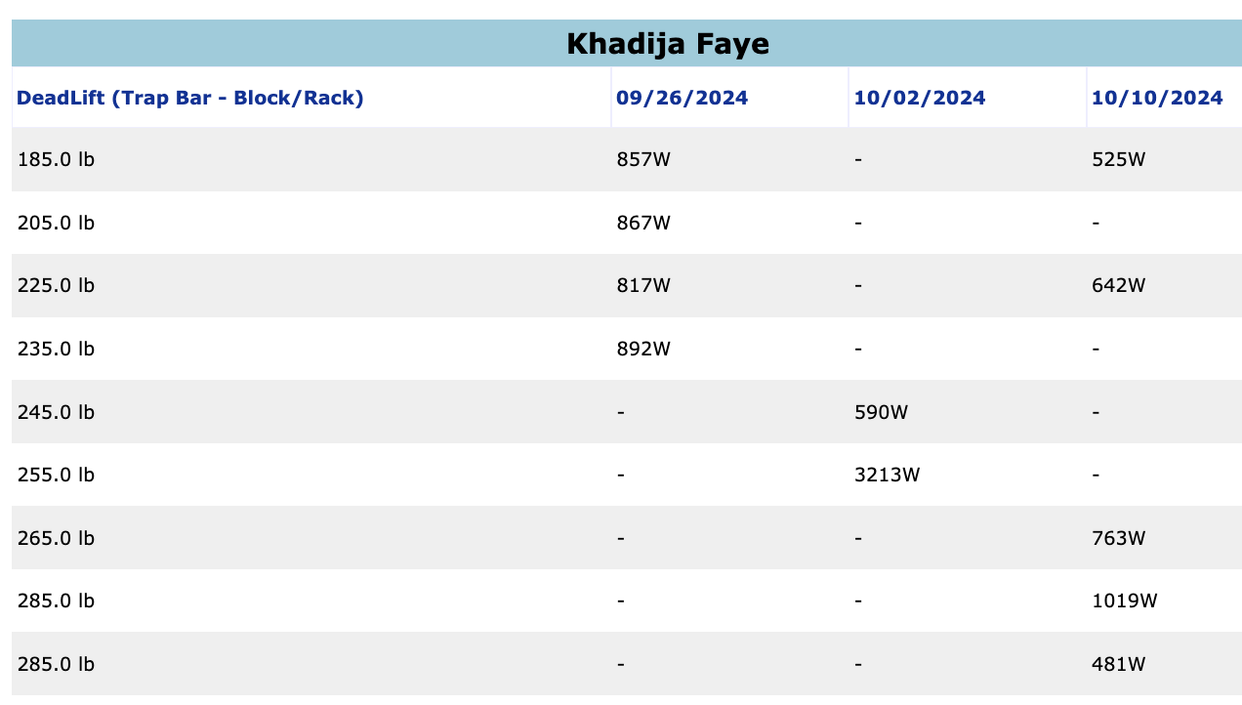
Faye – Deadlift

Slide 21
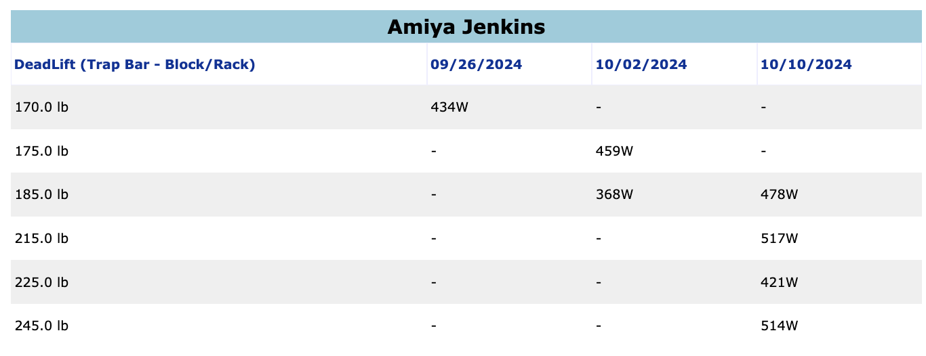
Jenkins – Deadlift

Slide 22
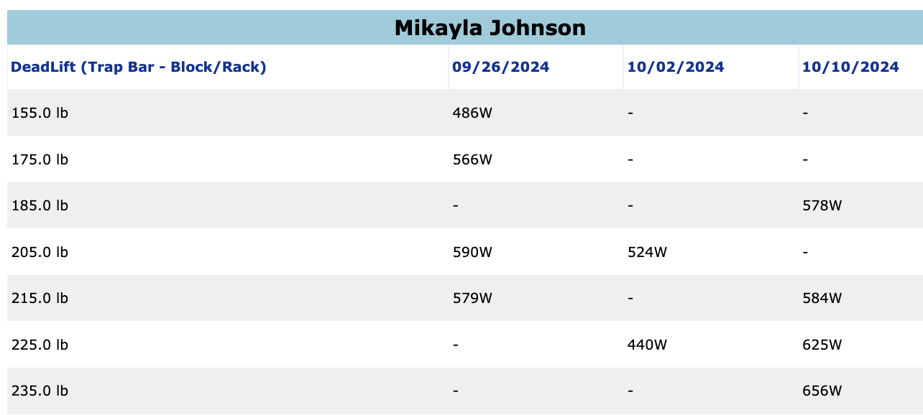
Johnson – Deadlift

Slide 23
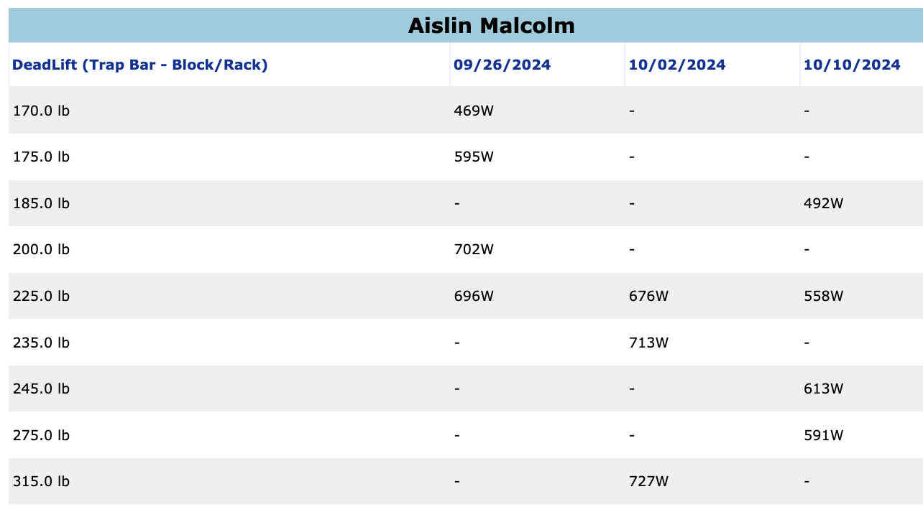
Malcolm – Deadlift

Slide 24
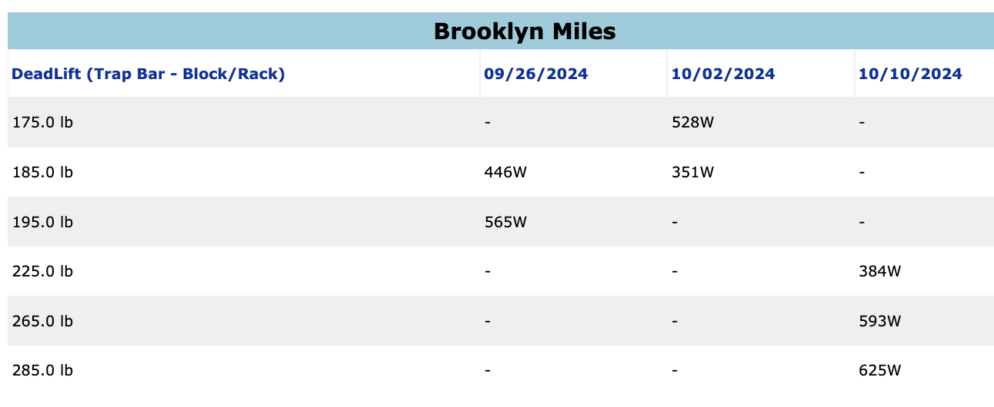
Miles – Deadlift

Slide 25
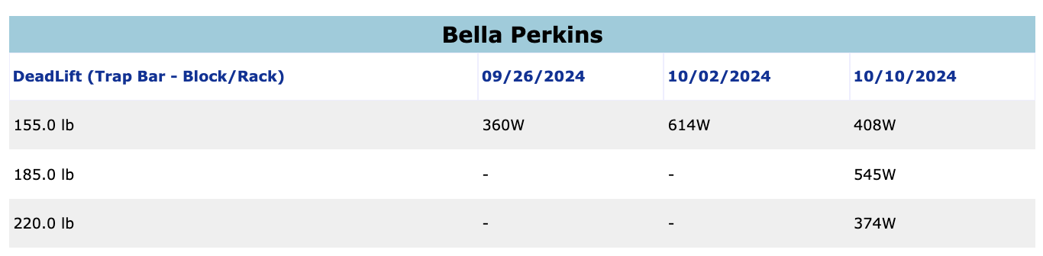
Perkins – Deadlift

Slide 26
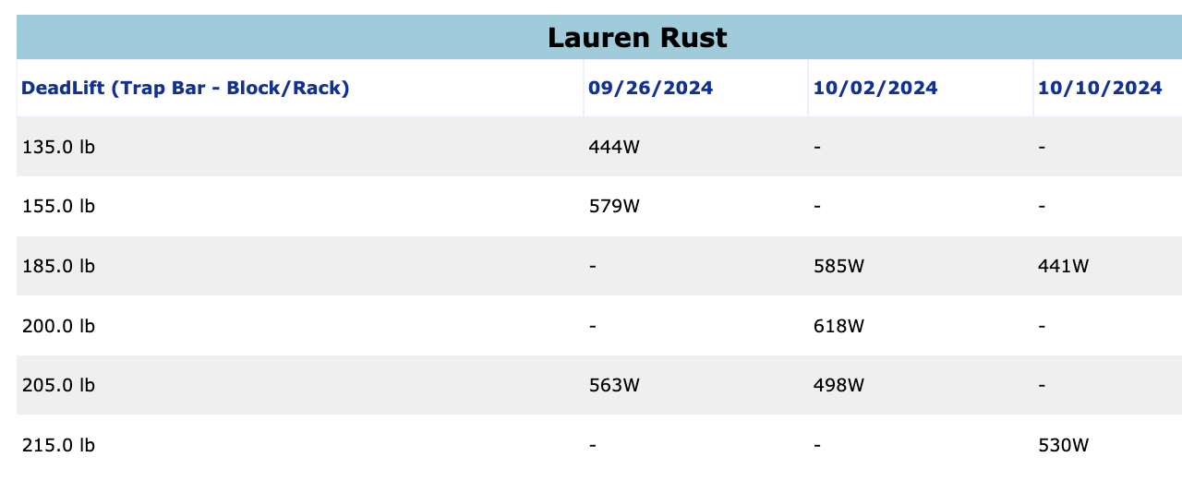
Rust – Deadlift

Slide 27
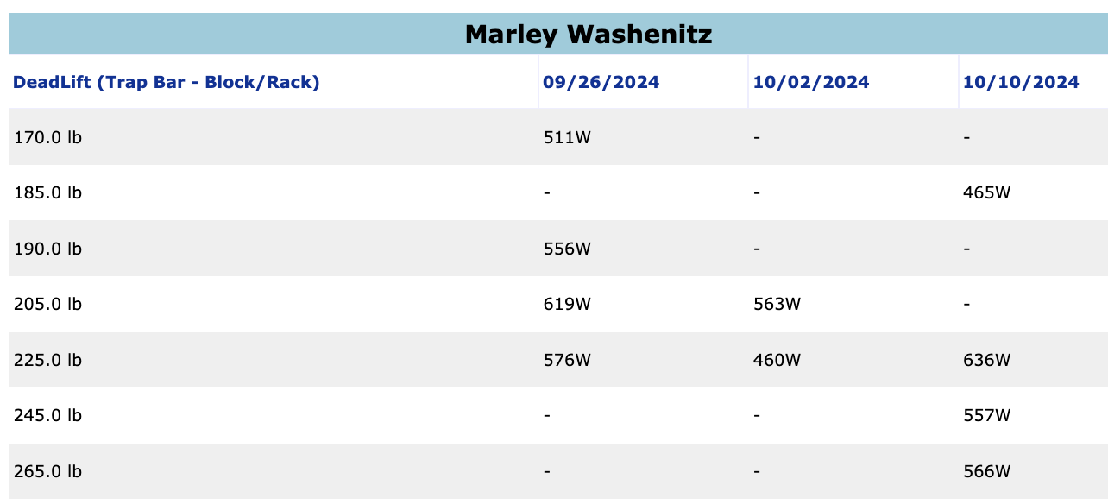
Washenitz – Deadlift

Slide 28
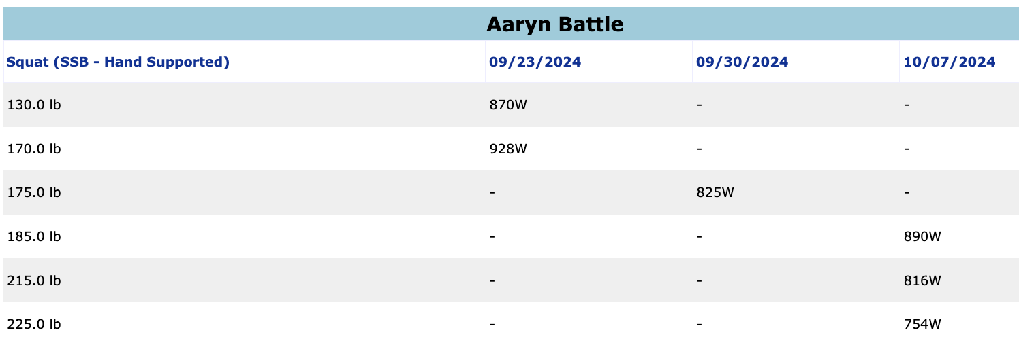
Battle – Squat

Slide 29
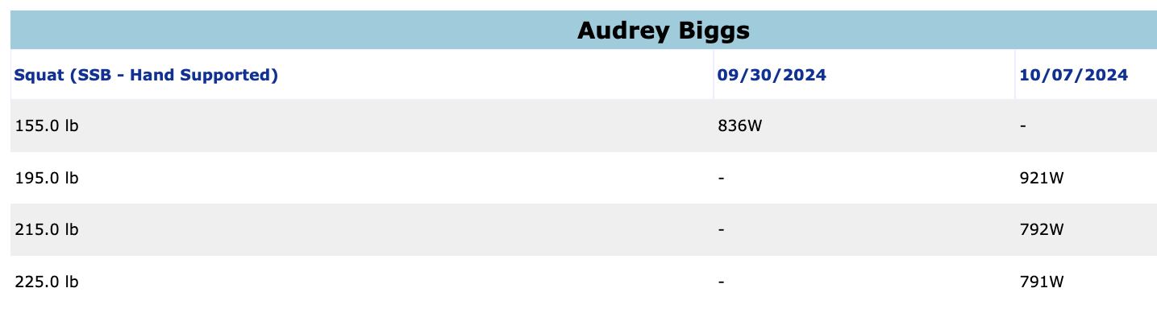
Biggs – Squat

Slide 30
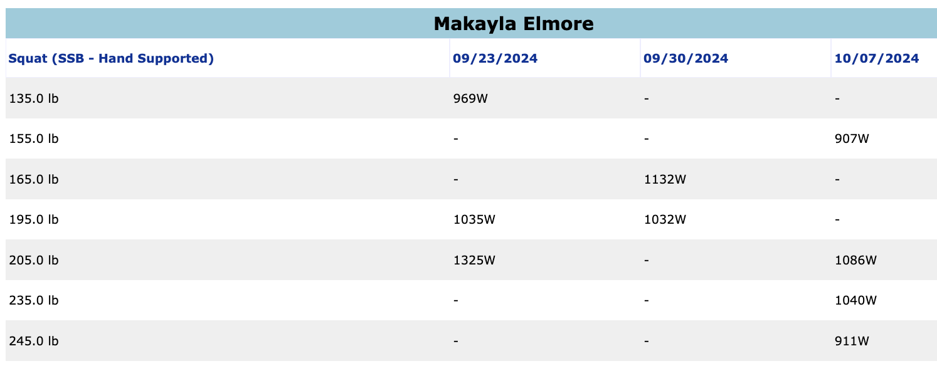
Elmore – Squat

Slide 31
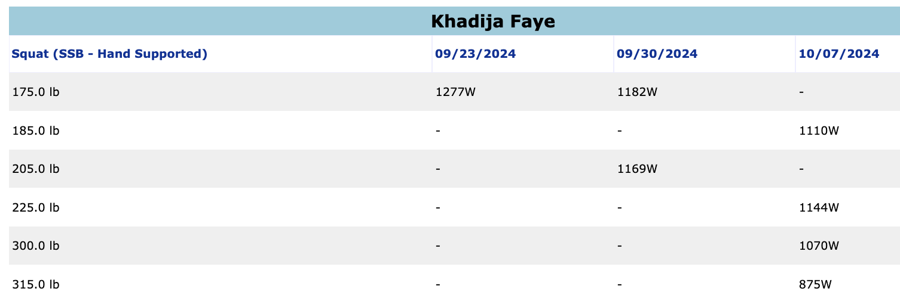
Faye – Squat

Slide 32
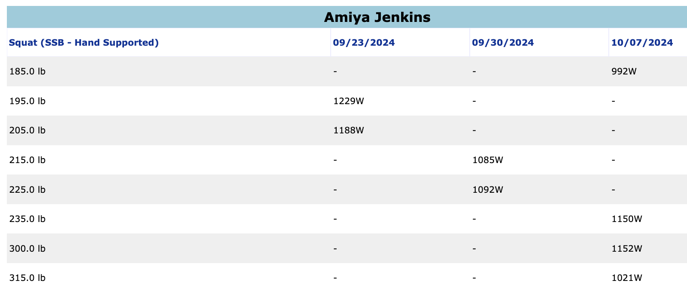
Jenkins – Squat

Slide 33
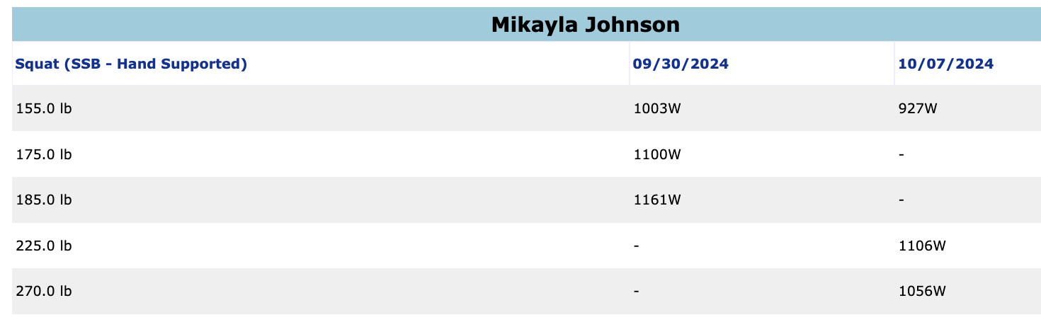
Johnson – Squat

Slide 34
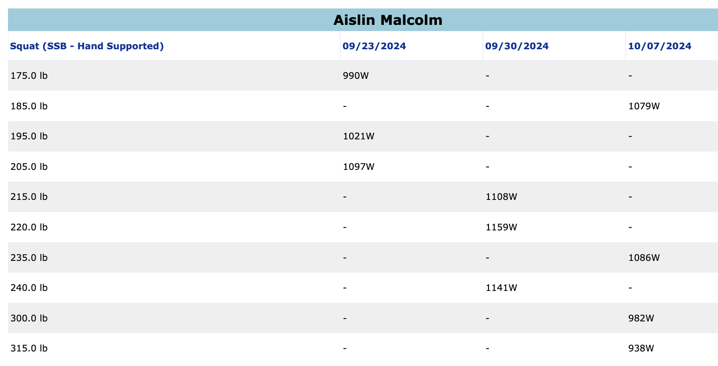
Malcolm – Squat

Slide 35
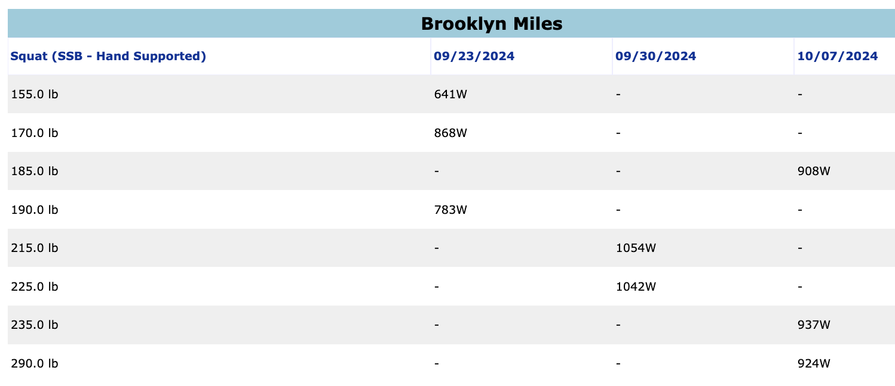
Miles – Squat

Slide 36
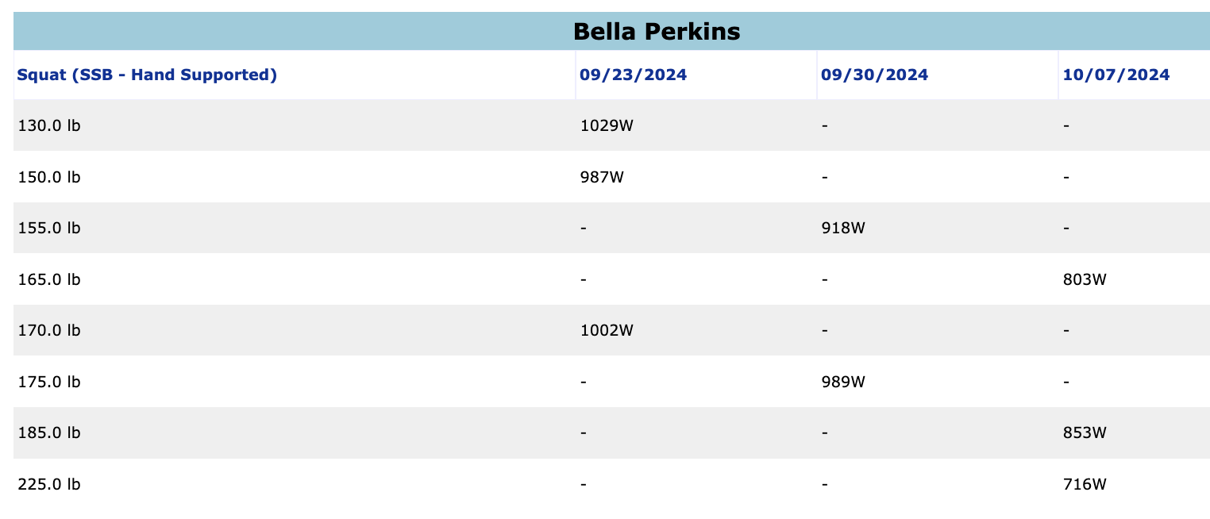
Perkins – Squat

Slide 37
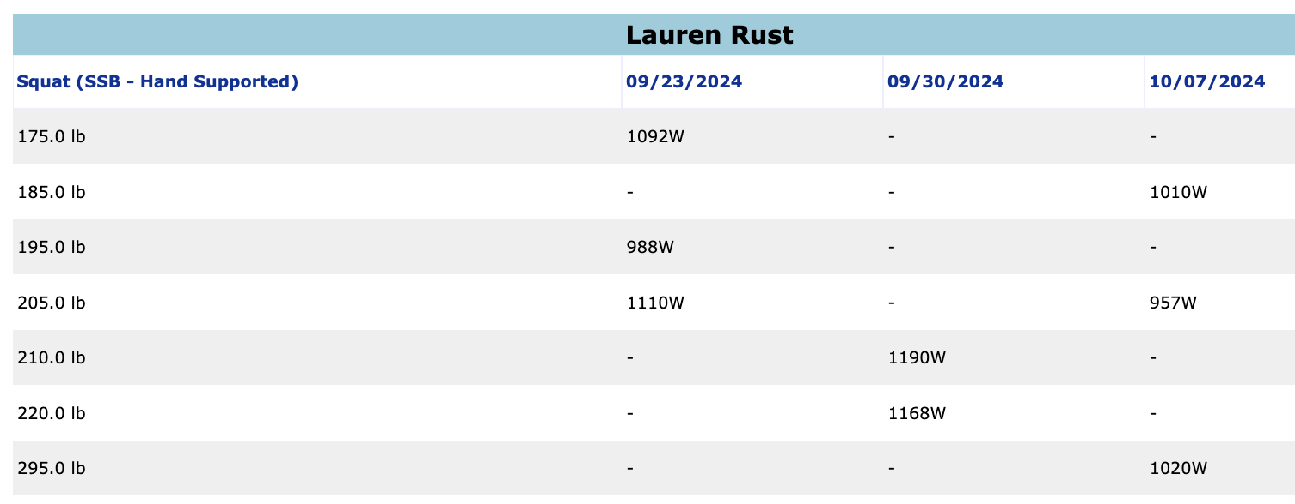
Rust – Squat

Slide 38
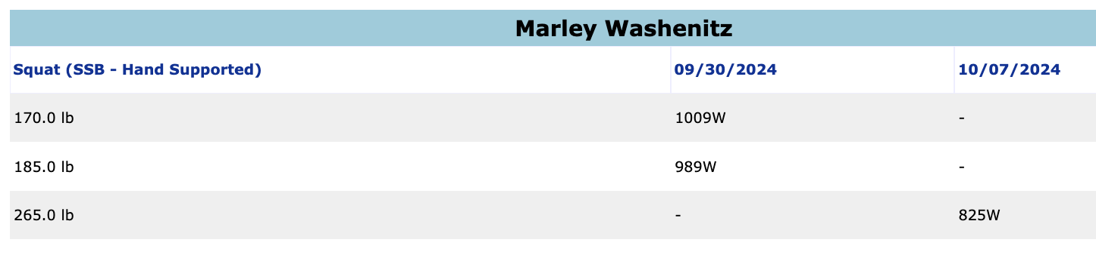
Washenitz – Squat

Slide 39
PlayerLoad Breakdown (Game AVG = 680 PlayerLoad)
Average Game PlayerLoad
680 + (Over 100%) | Very High
544 - 680 (80 - 100%) | High
408 – 544 (60 - 80%) | Medium
0 - 408 (0 - 60%) | Low
Very High (>100%)
High (80 – 100%)
Medium (60 – 80%)
Low (< 60%)

Slide 40
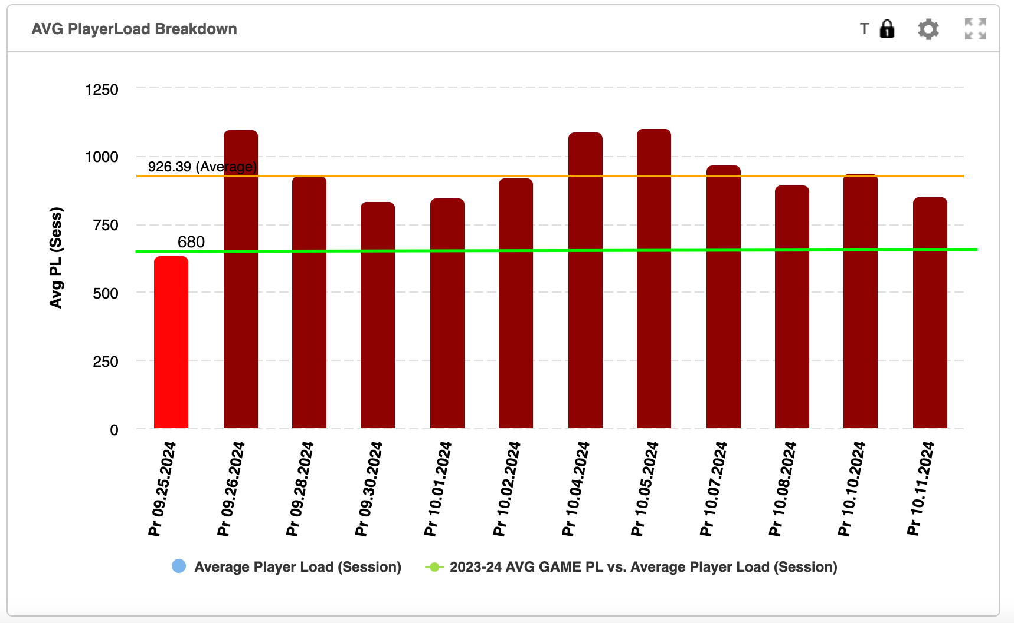
PlayerLoad Breakdown (Practice 9/25-10/11)
Very High (>100%)
High (80 – 100%)
Medium (60 – 80%)
Low (< 60%)
Notes:
10.2.24- Only has Data for Battle, Rust, and Washenitz

Slide 41
4-Week Preseason Recap – Cycle 1 (08/26-09/21)
Timeline:
4 Weeks
16 Training Sessions
Athlete Health Considerations:
1 Achilles Rupture
2 Shoulder rehab/prehab
Focus Lifts:
Barbell Back Squat
Barbell Bench Press
Barbell RDL
Trap Bar Deadlift
Week 1:
Squat 3 x 8 @ 65, 75, 75%
Bench 3 x 6 @ 65%
Barbell RDL 3 X 5 @ 65, 75, 75%
Week 3 :
Squat 3 x 5 @ 70, 80, 90%
Bench 3 x 3 @ 70, 80, 90%
Trap Bar Deadlift 3 X 5 @ No set %
Week 2 :
Squat 3 x 6 @ 65, 75, 75%
Bench 3 x 5 @ 65%
Barbell RDL 3 X 5 @ 65, 75, 75%
Week 4 :
Squat 3 x 3 @ 65, 75, 75%
Bench 3 x 3 @ 70, 80, 90%
Trap Bar Deadlift 3 X 5 @ 75%

Slide 42
Cycle 1 Progression: Battle
Back Squat
6 reps | 175
5 reps | 195
3 reps | 205
Barbell Bench Press
6 reps | 80
5 reps | 100
3 reps | 110
RDL
5 reps | 130
5 reps | 150
Trap Bar Deadlift
5 reps | 185
5 reps | 215

Slide 43
Cycle 1 Progression: Jenkins
Back Squat
6 reps | 155
5 reps | 205
3 reps | 240
Barbell Bench Press
6 reps | 90
**3 reps | 115
3 reps | 120
RDL
5 reps | 105
5 reps | 125
Trap Bar Deadlift
5 reps | 185
5 reps | 215
**Failed @ 3 reps Week 3, but completed 3 reps at increased weight Week 4!

Slide 44
Cycle 1 Progression: Miles
Back Squat
6 reps | 145
5 reps | 225
3 reps | 240
Barbell Bench Press
6 reps | 80
5 reps | 105
3 reps | 115
RDL
5 reps | 155
5 reps | 180
Trap Bar Deadlift
5 reps | 225
5 reps | 225

Slide 45
Cycle 1 Progression: Perkins
Back Squat
6 reps | 110
5 reps | 175
3 reps | 190
Barbell Bench Press
6 reps | 75
5 reps | 100
3 reps | 105
RDL
5 reps | 130
5 reps | 150
Trap Bar Deadlift
5 reps | 185
5 reps | 215

Slide 46
Cycle 1 Progression: Washenitz
Back Squat
6 reps | 125
5 reps | 225
3 reps | 240
Barbell Bench Press
6 reps | 90
5 reps | 115
3 reps | 120
RDL
5 reps | 155
5 reps | 180
Trap Bar Deadlift
5 reps | 185
5 reps | 225

Slide 47
Cycle 1 Progression: Biggs
Back Squat
6 reps | 75
5 reps | 165
3 reps | 195
Barbell Bench Press
6 reps | 65
5 reps | 85
3 reps | 90
RDL
5 reps | 95
5 reps | 105
Trap Bar Deadlift
5 reps | 185
5 reps | 225

Slide 48
Cycle 1 Progression: Johnson
Back Squat
6 reps | 180
5 reps | 180
3 reps | 205
Barbell Bench Press
6 reps | 75
5 reps | 80
3 reps | 105
RDL
5 reps | 95
5 reps | 105
Trap Bar Deadlift
5 reps | 185
5 reps | 225

Slide 49
Cycle 1 Progression: Malcolm
Back Squat
6 reps | 155
5 reps | 225
3 reps | 235
Barbell Bench Press
6 reps | 90
**3 reps | 115
3 reps | 120
RDL
5 reps | 195
5 reps | 225
Trap Bar Deadlift
5 reps | 185
5 reps | 225
**Failed @ 3 reps Week 3, but completed 3 reps at increased weight Week 4!

Slide 50
Cycle 1 Progression: Elmore
Back Squat
6 reps | 140
5 reps | 185
3 reps | 195
Barbell Bench Press
6 reps | 70
5 reps | 95
3 reps | 100
RDL
5 reps | 95
5 reps | 105
Trap Bar Deadlift
5 reps | 185
5 reps | 215

Slide 51
Cycle 1 Progression: Rust
Back Squat
6 reps | 135
5 reps | 205
3 reps | 225
Barbell Bench Press
6 reps | 90
5 reps | 115
3 reps | 120
RDL
5 reps | 155
5 reps | 180
Trap Bar Deadlift
5 reps | 135
5 reps | 175

Slide 52
Cycle 1 Progression: Faye
Back Squat
6 reps | 165
5 reps | 215
3 reps | 230
Barbell Bench Press
6 reps | 70
5 reps | 95
3 reps | 105
RDL
5 reps | 135
5 reps | 185
Trap Bar Deadlift
5 reps | 185
5 reps | 275

Slide 53
4-Week Preseason Recap – Cycle 2 (09/23-Present)
Timeline:
2 Weeks
8Training Sessions
Athlete Health Considerations:
1 Achilles Rupture
2 Shoulder rehab/prehab
Focus Lifts:
Hatfield Hands-Free Squat
Barbell Bench Press
B Stance Trap Bar Deadlift
Incline Bench Press**
Week 1: 4 X 4 @ 0.6 m/s Velocity
Week 2: 4 X 4 @ 0.6 m/s Velocity

Slide 54
Cycle 2 Progression: Battle
Hatfield Hands Free Squat
170
175
Barbell Bench Press
70
90
B Stance Deadlift
205
225

Slide 55
Cycle 2 Progression: Jenkins
Hatfield Hands Free Squat
205
225
Barbell Bench Press
90
95
B Stance Deadlift
170
175

Slide 56
Cycle 2 Progression: Miles
Hatfield Hands Free Squat
190
225
Barbell Bench Press
75
95
B Stance Deadlift
185
195

Slide 57
Cycle 2 Progression: Perkins
Hatfield Hands Free Squat
170
175
Barbell Bench Press
70
90
B Stance Deadlift
205
225

Slide 58
Cycle 2 Progression: Washenitz
Hatfield Hands Free Squat
170
185
Barbell Bench Press
80
90
B Stance Deadlift
170
225

Slide 59
Cycle 2 Progression: Biggs
Hatfield Hands Free Squat
125
155
Barbell Bench Press
65
75
B Stance Deadlift
155
**155
** Increased speed (0.47 m/s to 0.6 m/s)

Slide 60
Cycle 2 Progression: Johnson
Hatfield Hands Free Squat
170
185
Barbell Bench Press
80
85
B Stance Deadlift
150
205

Slide 61
Cycle 2 Progression: Malcom
Hatfield Hands Free Squat
205
240 (0.64 m/s!!)
Barbell Bench Press
80
90
B Stance Deadlift
225
235

Slide 62
Cycle 2 Progression: Elmore
Hatfield Hands Free Squat
135
195
Barbell Bench Press
80
85
B Stance Deadlift
145
155

Slide 63
Cycle 2 Progression: Rust
Hatfield Hands Free Squat
205
220
Barbell Bench Press
80
90
B Stance Deadlift
155
205

Slide 64
Cycle 2 Progression: Faye
Hatfield Hands Free Squat
175
205
Barbell Bench Press
80
90
B Stance Deadlift
235
255

